Slide 1

Credit Card Customer Churn
Predictive model

Slide 2


Overview
Objective | Develop a predictive model to identify the likelihood existing credit card customers will churn.
Data used | Historical customer snapshot
Problem | 16% of credit card customers churned over the past year Manager needs to understand which customers are most likely to churn
Validation results
97%
recall
96%
accuracy
3%
Churned customers misclassified

Slide 3
Approach: Data wrangling
Source | Feature | Description
Company Records | Churn Age Gender Dependent_count Education_Level Marital_Status Income_Category Card_Category Total_Relationship_Count Months_on_book Months_Inactive_12_mon Contacts_Count_12_mon Credit_Limit Total_Revolving_Bal Avg_Open_To_Buy Total_Trans_Amt Total_Amt_Chng_Q4_Q1 Total_Trans_Ct Total_Ct_Chng_Q4_Q1 Avg_Utilization_Ratio | flag indicating if customer relationship still exists customers age in years male or female number of dependents educational qualification of the account holder categorized as married, single, divorced, unknown range of annual income type of card total number of products held by customer months of relationship with company number of months inactive in the last 12 months number of contacts in the last 12 months credit limit on the credit card total revolving balance on the credit card open to buy credit line (average of last 12 months) total amount from transactions over the last 12 months change in transaction amount (Q4 over Q1) total count of transactions over the last 12 months change in transaction count (Q4 over Q1) utilization ratio average over the last 12 months

Slide 4
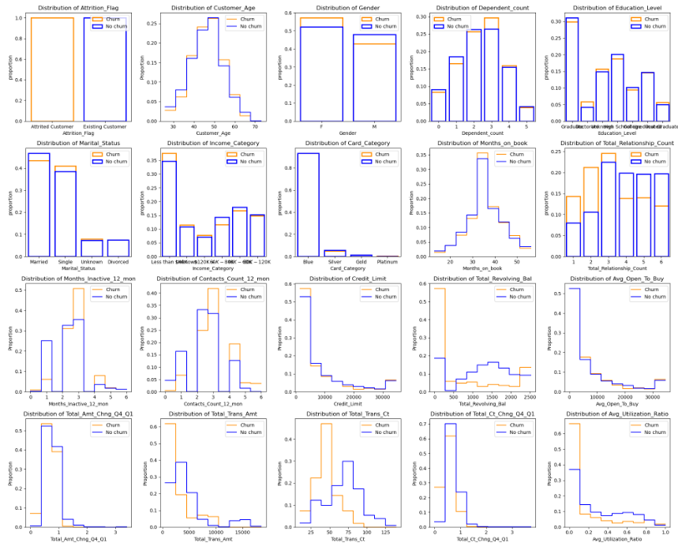
Approach: EDA
Proportional distribution of churn and non-churn populations
Certain features show visible differences in population distribution
Total transaction amount
Total transaction count
Average utilization ratio

Slide 5
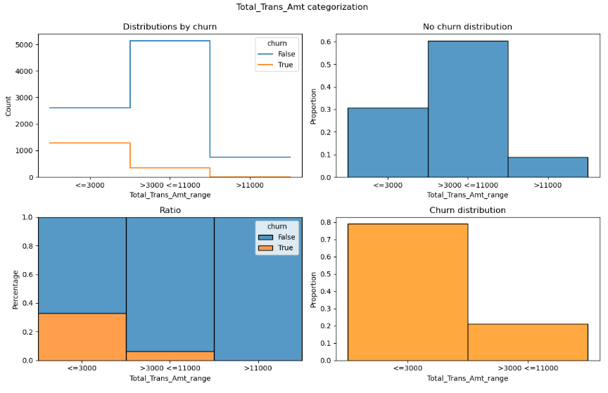
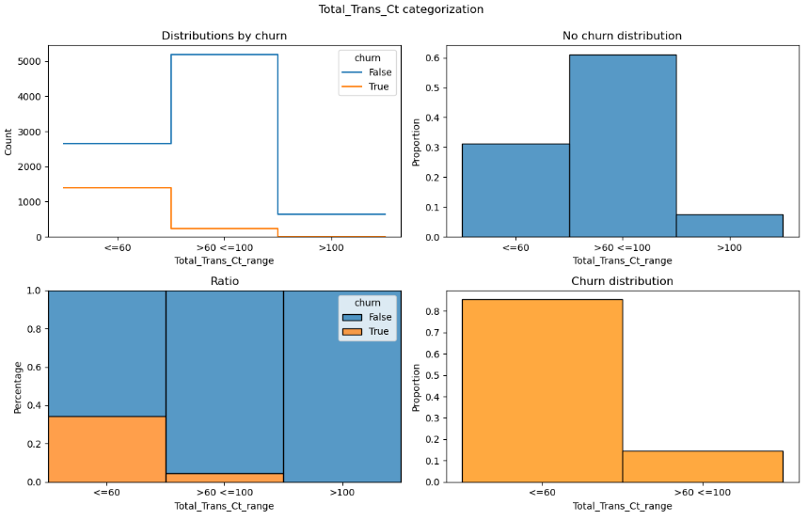
Approach: EDA Transaction Activity
Churn population skewed right
As activity increases, proportion of churned customers decreases
All churned customer have less than $11,000 in total transactions and less than a 100 transaction count.

Slide 6
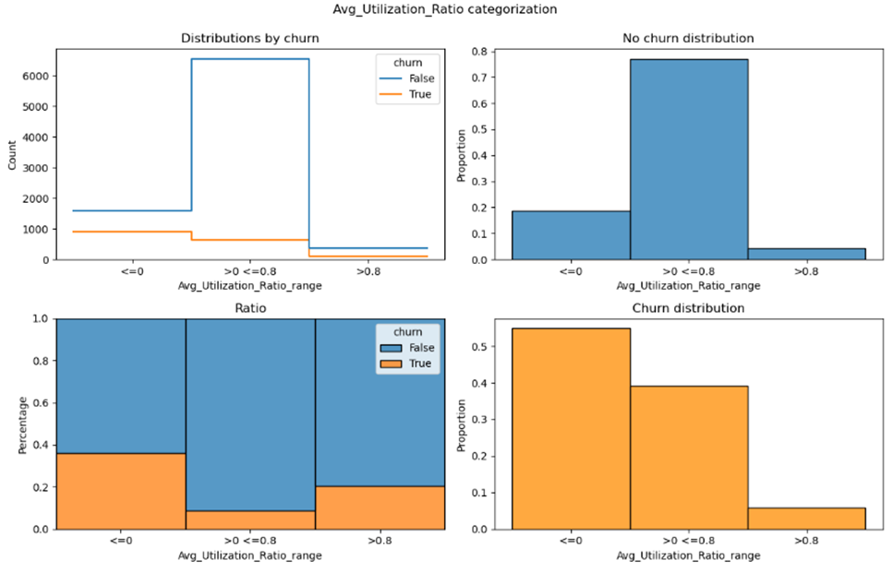
Approach: EDA Utilization
Churn population skewed right
Proportion of churned customers decreases in the middle of utilization range
Customers with no usage or maximizing as least 80% of their credit line have been more likely to churn.
Moderate levels of utilization appear to correlate with customers remaining with the company.

Slide 7
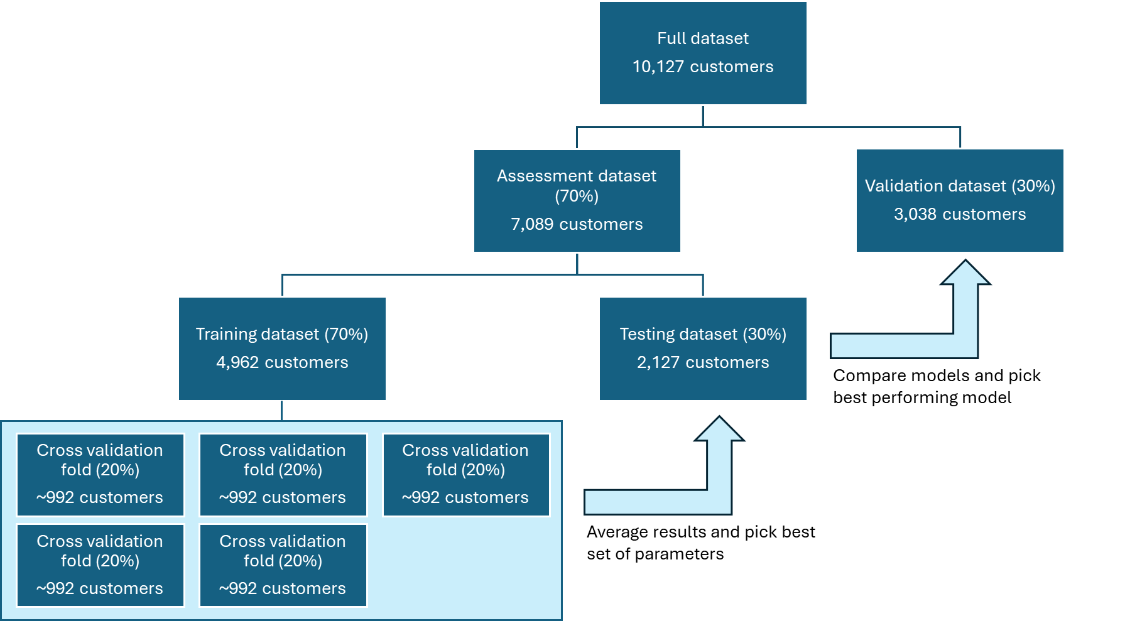
Approach: Model selection
Performance Metrics
Primary | Recall Percentage of actual churn customers predicted to churn
Secondary | Receiver Operating Characteristic (ROC) curve Illustrates classifier performance at a range of threshold settings, showing the trade off between sensitivity and specificity. Lift curve Shows effectiveness of model by comparing results obtained with and without the model. (i.e. Top X% of samples perform X times better than random).
Data split

Slide 8
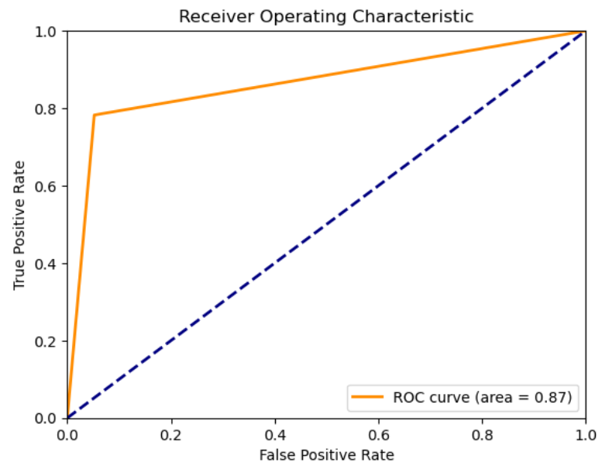
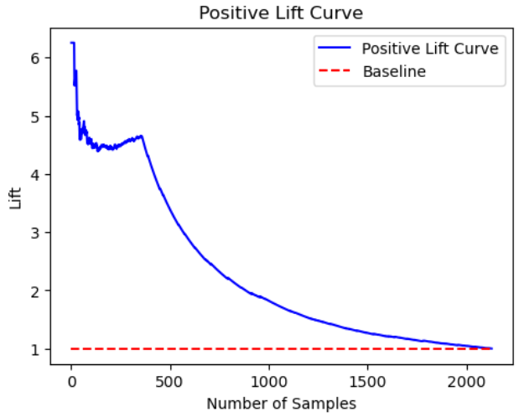
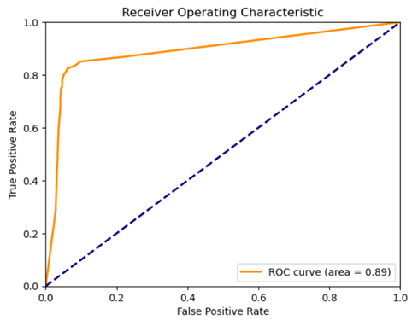
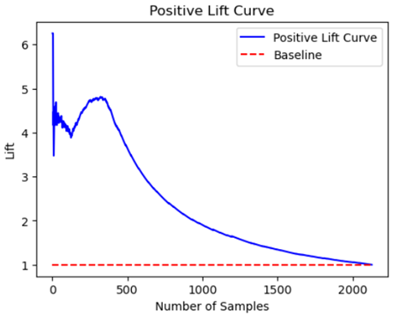
Approach: Model selection
Using assessment dataset
Baseline | Simple decision tree classifier Okay results
Tuned Decision Tree | Tested 324 sets of parameters to find most effective decision tree Better results
78%
recall
81%
recall

Slide 9
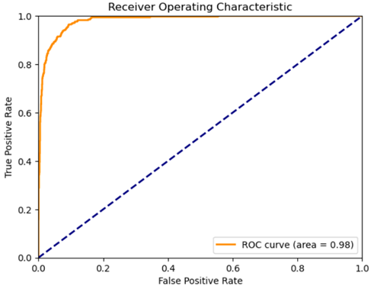
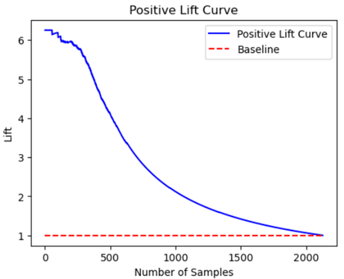

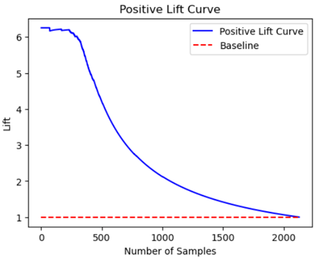
Approach: Model selection
Using assessment dataset
Random Forest | Tested 24 iterations of variables to find most effective Random Forest Good results
CatBoost | Standard CatBoost classifer Best results
84%
recall
86%
recall

Slide 10
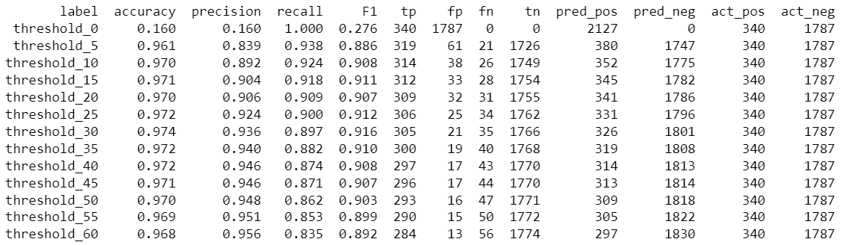
Approach: Model selection
Winning model
Threshold Assessment
Further assessment was given to the threshold used for predicting churn (instead of the default 50%).
Reducing the threshold to 5% achieved almost 94% recall without massively inflating the size of the positive prediction class.
CatBoost model showed best performance

Slide 11
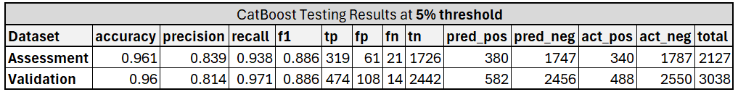
Validation CatBoost model
Validation | Of the 488 customers that churned, the model correctly included 474 in the positive class. Only 3% of the churned customers were missed. Of the 582 in the positive class, 19% did not churn.
Validation test results

Slide 12
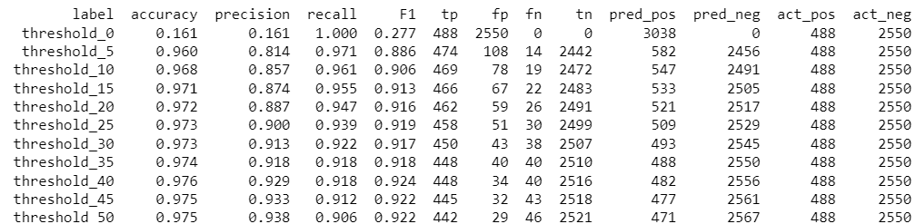
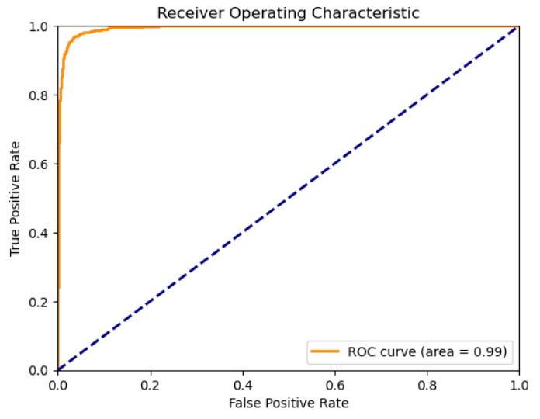
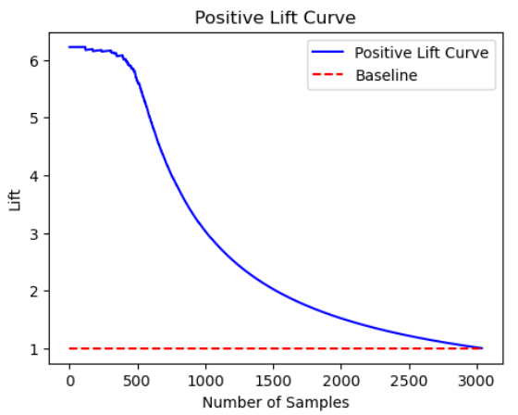
Findings: Model Results
Threshold assessment
ROC curve
Lift curve

Slide 13
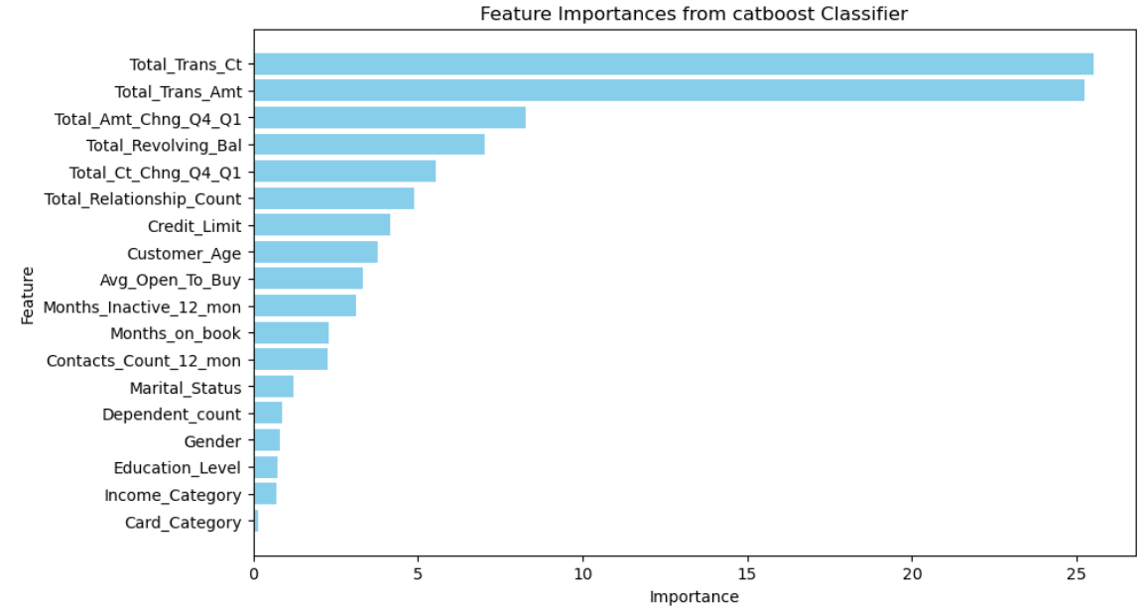
Findings: Model Results
Feature importance

Slide 14



Use cases
Reward programs | General changes to all customers Implementing or enhancing existing reward programs to incentivize the size and volume of transactions.
Survey | Identify the segment of customers most likely to churn. Proactive outreach to understand what is preventing these customers from using their cards more. Collect feedback to focus retention efforts in the most relevant areas.
Targeted incentives | Reduce interest rates Customized reward offerings

Slide 15
What’s next?
1 | Hyper tune model to increase performance
2 | Monitor threshold to ensure 5% remains appropriate as population changes overtime
3 | Automate data refresh and training
4 | Build data quality checks into the workflow

